Slide 1
Sugon Server Blade Servers
Moscow, 12/2015

Slide 2
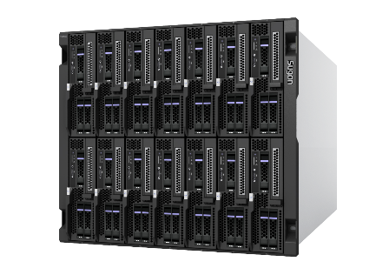
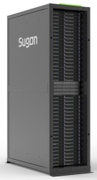
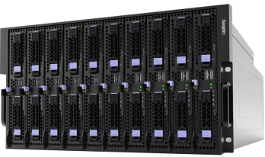
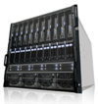
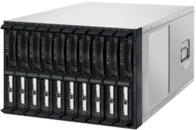
Milestone of Sugon Blade Servers
TC6600
2014
TC5600
2013
TC4600
2012
TC3600
2010
All Designed by Sugon, 7U10Blade
First Blade Server of SSI Architecture of Intel
Special for HPC, 5U 10/14 Blades
High Performance to Price Ratio
TC2600
2007
Fusion
Architecture
TC1600
2006
High Density
Cabinet Level
Internet,
Starter of China Blade Server

Slide 3
HP and Sugon Break Thought in Blade Market
Rank | Vendor | Unit (Q1) | Share (Q1) | YOY Growth
1 | HP | 6528 | 26.0% | 14.4%
2 | Sugon | 4654 | 18.6% | 172.5%
3 | Huawei | 4240 | 16.9% | 3.8%
4 | Lenovo | 3591 | 14.3% | #DIV/0!
5 | Dell | 3173 | 12.6% | 59.8%
6 | Inspur | 1494 | 5.9% | 120.4%
7 | Others | 1454 | 5.8% | -21.6%
Blade segment grew 28.0% in Q1.
Huawei educated customer to use blade and to selling value add product like software and solution
HPC deal boost Sugon performance due to new HPC optimized blade server
High-End blade will gain an excellent windows to grow in some mature industry.
Blade have limited Internal storage, however the whole industry may quickly shifting to request the storage rich model to handle the big data issue, we clearly saw telecom began to purchase storage rich 2s rack server(balance storage and compute) instead blade

Slide 4
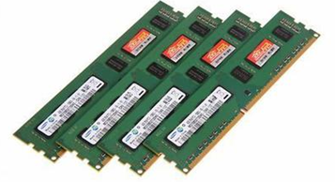
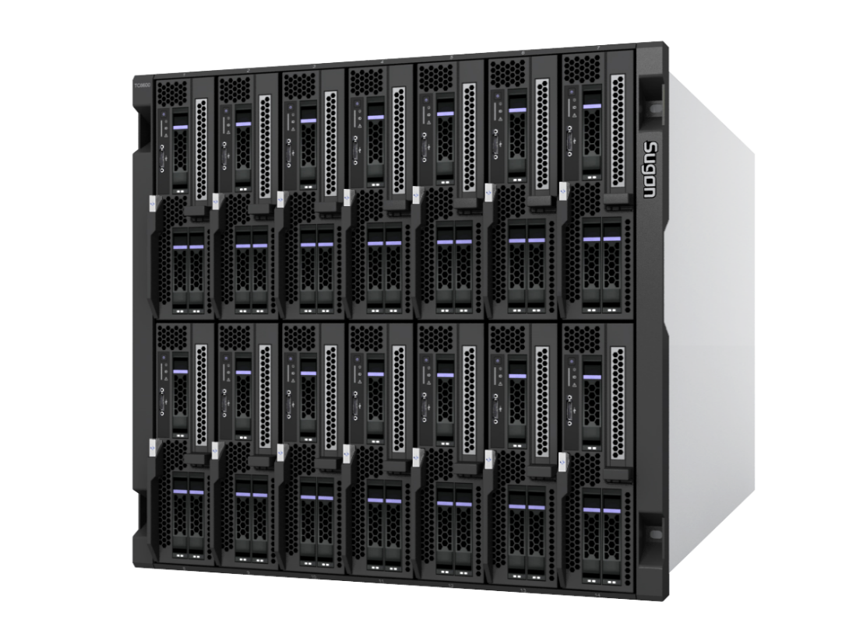
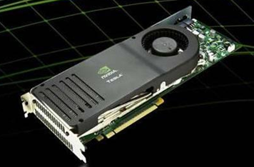
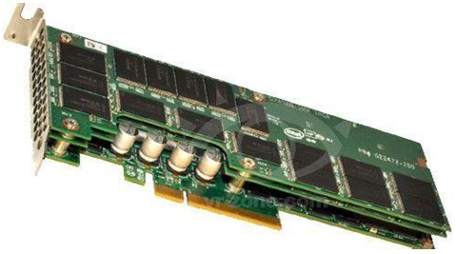
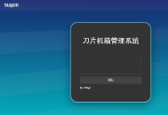
TC6600 Blade Server
Memory Computing
Computing
300W GPU Card
Network
PCI-E SSD Card
Storage
TC6600
Visualization Management
All-in-one Solutions
Notes:
In the era of cloud computing, Sugon launched this new-generation blade server, integrates computing, storage, switching, and management subsystems to form a converged infrastructure platform.
At 22 January 2015, Sugon got a bid of China Tax, the contract price is about 3.5M$.

Slide 5
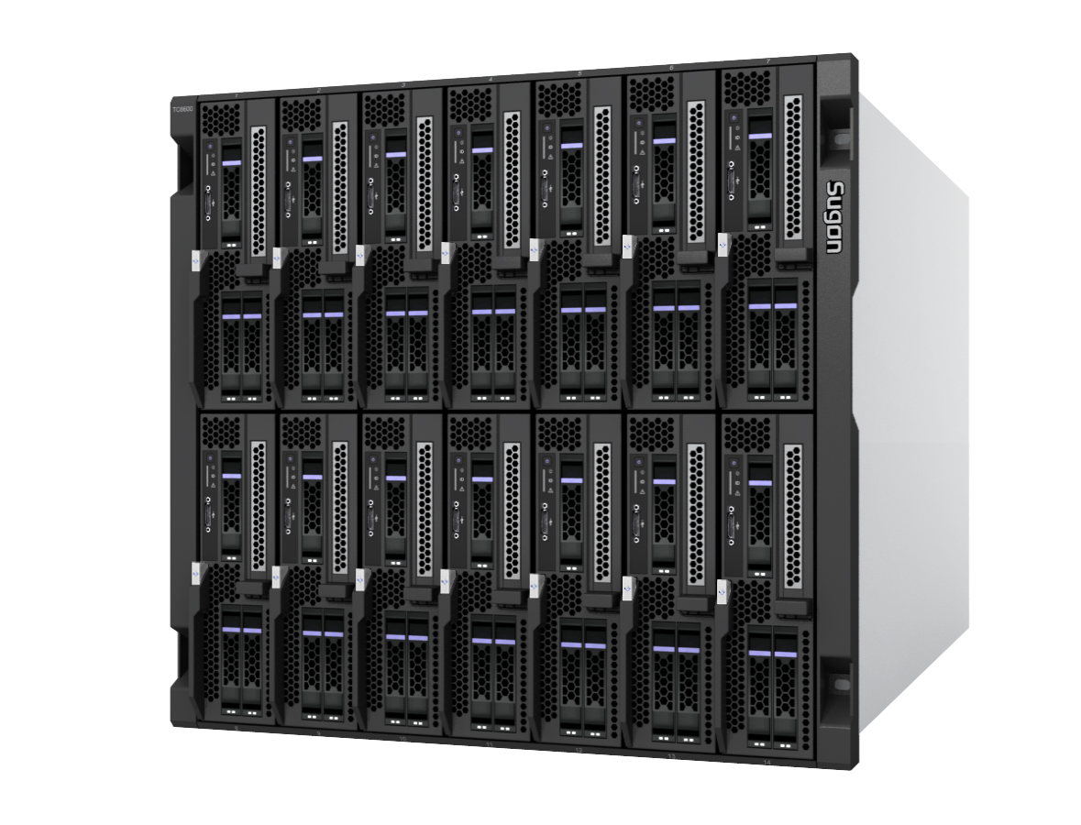
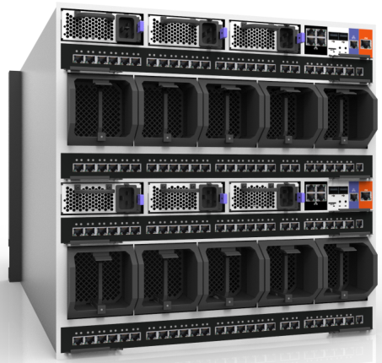
TC6600 Product View
Front View
Back View

Slide 6
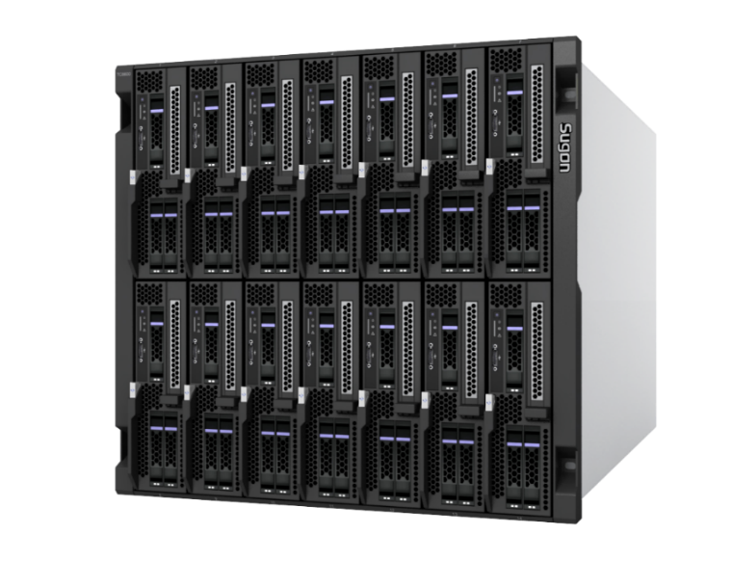
TC6600 Fusion Architecture
Flex 2S/ 4S
Flex Memory
Intel 2-way
Intel 4-way, AMD 4-way
Half/Full Blade
Blade: 16/24DIMM
Blade: 32/48DIMM
Flex Computing
Flex Networking
8 Blades：
2 Computing Blade
2 Storage Blades
IO Blade/GPU Blade
2 model 4-way Blade
Blade: 2/4/6 GE
Blade: 10/20/40GE
Blade: 8 /16G FC/100G
Support
Flex Storage
Flex Redundent
Blade：2/3/4HDD
Blade：16HDD
Chassis：112HDD
Support both of DAS and Distributed Storage Solution
TC6600
Power：N+N
Network：N+N
Cooling FANs：N+N
Management：1+1
Backpanel：1+1

Slide 7
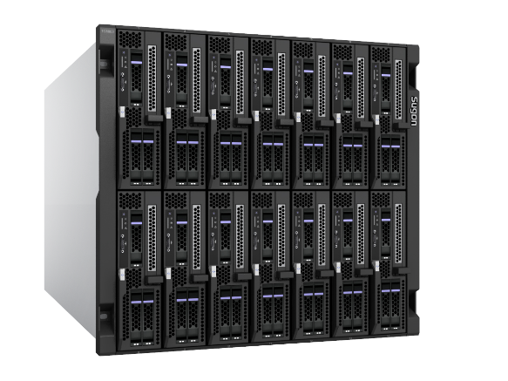
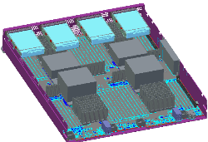
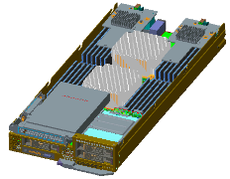
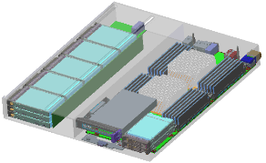
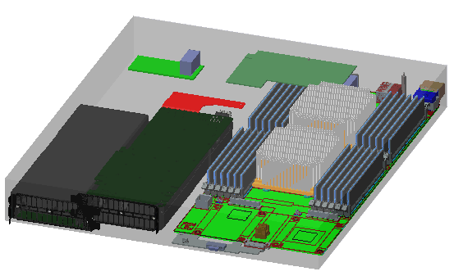
TC6600 Module Family
Blades
CB80-G20
E7-4800V2/V3 4-way Blade
CB85-G
AMD 6300 140w 4-way Blade
CB50-G20
CB60-G20
Computing Blade
CB50-S20
CB60-S20
Storage blade
CB50-E20
CB60-E20
GPU & IO Blade
Inter-connection Module
24-port GE switch
48-port GE switch
24-port
10GE switch
48-port
10GE switch
24-port
FC Switch
48-port
FC switch
TC6600
28-port
10G passthrough module
36-port
100G switch

Slide 8
Blade Specifications
Model | CB50-G20 | CB60-G20 | CB80-G20 | CB85-G10
CPU | Intel E5-2600 v3 series（MAX 135W TDP） | Intel E5-2600 v3 series（MAX 135W TDP） | Intel E7-4800V2 series（MAX130W TDP） | 4个AMD 6000series（MAX 140W TDP）
Memory | 16个DDR4 slot，2133/1866/1600/1333MHz | 24个DDR4 slot，2133/1866/1600/1333MHz | 48个DDR3 slot，1600/1333/1066MHz | 32个DDR3 slot，1600/1333/1066MHz
harddisk | MAX:2.5 inch local hard disk*4 /hard disk*3+PCI-e slot*1，support SAS/SATA/SSD | MAX:2.5 inch local hard disk*4 /hard disk*3+PCI-e slot*1，support SAS/SATA/SSD | MAX:2.5 inch local hard disk*4 support SAS/SATA/SSD | MAX:2.5 inch local hard disk*4 support SAS/SATA/SSD
RAID | LSI 3008 HBA RAID0，1，1E，10 | LSI 3008 HBA controller RAID0，1，1E，10 | LSI 3108 RAID controller （RAID 0,1,5） | LSI 3108 RAID controller （RAID 0,1,5）
IO HDMI | Mezz slot*2，dural port installable/4-port XFP；2-port HCA subcard；4-port GBPS subcard, etc. LOM2×1000M Ethernet interface； | Mezz slot*2，dural port installable/4-port XFP；2-port HCA subcard；4-port GBPS subcard, etc. LOM2×1000M Ethernet interface； | Mezz slot*4，dural port installable/4-port XFP；2-port HCA subcard；4-port GBPS subcard, etc. LOM2×1000M Ethernet interface； | Mezz slot*4，dural port installable/4-port XFP；2-port HCA subcard；4-port GBPS subcard, etc. LOM2×1000M Ethernet interface；

Slide 9
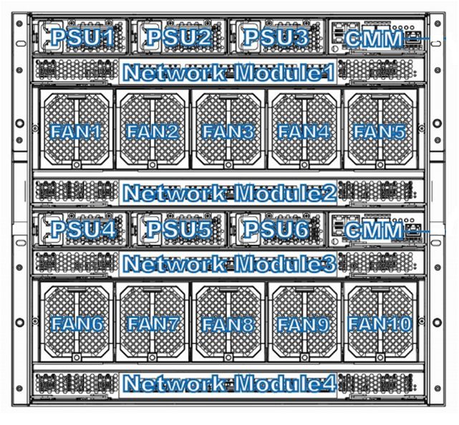
TC6600 Backview

Slide 10
TC6600 Network & IO Expansion
Module-type | supplier | description | Title
GBPS exchange module | Brocade | 24-port GE exchange module internal provided：14-port GE interconnection external provided：4-port GE electrical port+10G SFP*2+ port | SW-2040
48-port GBPS exchange module | Brocade | 48-port GBPS exchange module internal provided：28-port 1GE interconnection external provided：1GE electrical port*16+10G SFP*4+port | SW-2046
24-port XFP exchange module | Ruijie | 24-port 10G XFP exchange module internal provided：14-port 10GE interconnection external provided：10G SFP*16+port+40G QSFP*4+port | SW-6200
24-port with FC exchange module | Ruijie | 24-port 10G XFP exchange module internal provided：14-port 10GE interconnection external provided：10G SFP*8+port+40G QSFP*4+port+8G FC port*8 | SW-6200
XFP straight module | sugon | 14-port 10GEstraight module 14-port GEstraight module internal provided：14-port 10GE external provided：14-port 10G SFP+port | PT-2260

Slide 11
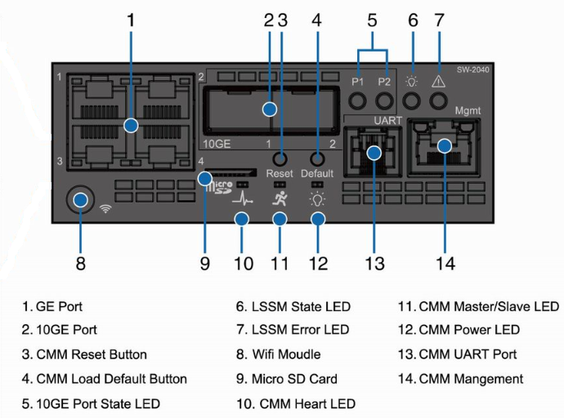
TC6600 BMC Module

Slide 12
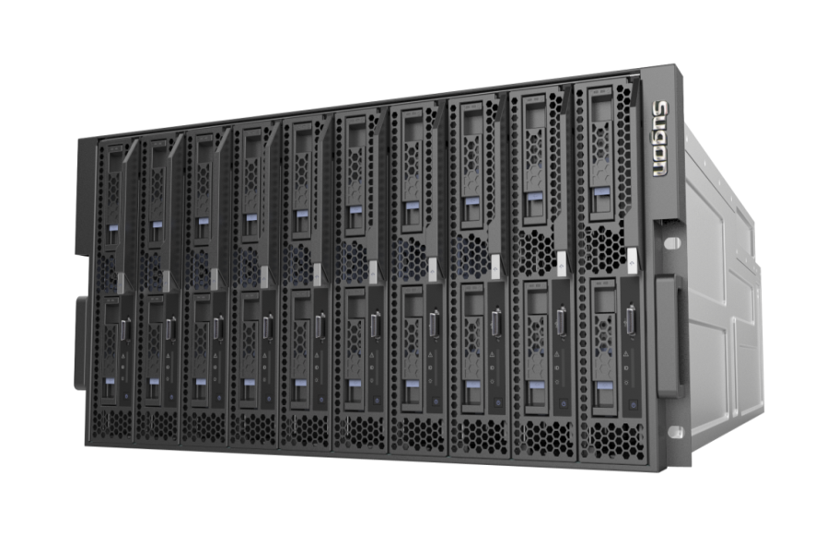
TC4600E
135W
E5-2600V3 CPU
Memory
16DIMM
24DIMM
Network
56G IB
100G IB
2*10GbE
Low Noise
5U 10Blade
Performance
100% up

Slide 13
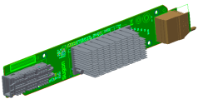
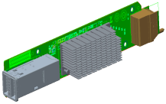
TC4600E Blade Specifications
Mezz Card
Model | CX50-G20 | CX60-G20
CPU | 2* intel E5-2600V Series（up to 135w CPU )
Memory | 16*DDR4 DIMM , 2133/1866 MHz | 24个DDR4 DIMM, 2133/1866 MHz
HDD | 2* 2.5”SAS/SSD/SATA HDD
RAID | LSI 3008， support raid0,1
IO | 1*PCIe Mezz Card
56G FDR IB
56Gb Mezz IB Card
2-port 10GbE
2-port 10Gb Mezz NIC
100G EDR IB
100Gb Mezz IB Card
1、Recommend CPU is E5-2680V3（ 12core，2.5GHz）
2、Optional 56Gb 、100Gb Infiniband, 10 GbE (Three for one)

Slide 14
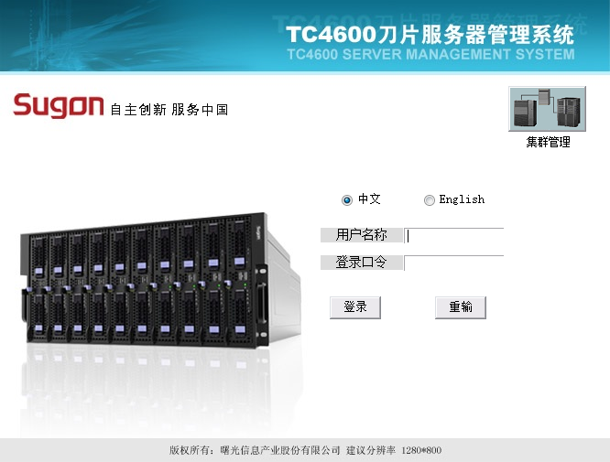
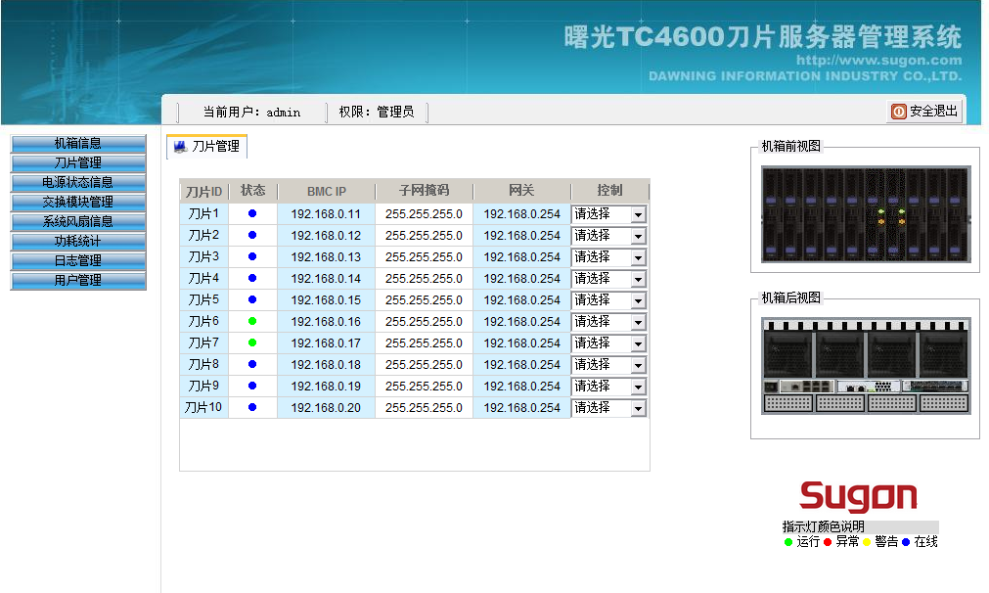
Blade System Management
Web interface；
Remote management as local access；
Remote KVM（rKVM）；
Remote Virtual Media（rMedia）；
Remote Power-on/off；
Automatic Power Management；
Automatic Cooling Management；
Support SNMP Protocol, excellent compatibility
GUI

Slide 15
TC6600 Competitiveness Overview
1. 2-Way Node
16/24DIMM mixed, Could bet 8DIMM by specification, also bet 24 DIMM by price and flexibility
Each node : 3 HDD+1 Full height& Half length Card, Sugon & Huawei
Each node : 16 HDD, Sugon, Huawei only 15 HDD
Each node：2* 300W GPU+1 standard card or 2 PCI-E×16+1 standard card, Only Sugon
Each node：2G Raid cache, Only Sugon
2. 4-Way Node
E7-48V2 processor only supported by IBM(Lenovo), Huawei and Sugon
48DIMM Except IBM use 2 full blade to realize 96DIMM, others are 32IDMM
4HDD Huawei 8HDD, IBM 4HDD, Others are only 2HDD
2G raid cache Only Sugon
AMD 四路刀片 HP, Dell and Sugon
3, Network & Density
6 Hotplug IO/Network Switch Module, Only HP, Dell and Sugon
4 Blade Chassis in 42U Cabinet, to sweep Huawei 12U Chassis out

Slide 17
TC4600E Specifications
 | TC4600E
Chessis | 5U/10片 双路计算节点
计算 节点 | Intel E5-2600V3 双路计算节点 (支持135w)
高速 网络 | 刀箱支持 可对外提供10个56Gbps的FDR Infiniband接口； 未来对外提供10个100Gbps的EDR Infiniband接口； 对外提供20个10Gbps 万兆SFP+接口；
千兆 网络 | 刀箱对外提供：2 *千兆交换模块 每个模块对外提供：6个千兆接口+2个SFP+
管理 | 提供1个CMM模块管理功能，支持IPMI和KVM over IP，提供基于web界面的嵌入式管理软件
散热 | 支持5组灵动智能散热模组
供电 | 4组高效热插拔冗余电源， 单体白金电源效率达94%以上
外形 | 5U刀片式服务器
TC4600E
全球首款
支持100G IB高速系统

Slide 18
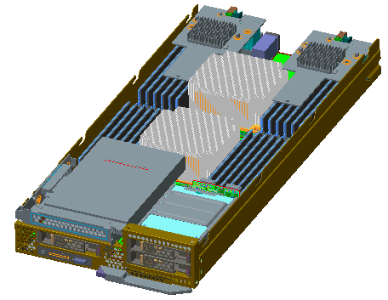
TC6600--Intel Grantly E5-2600V3 双路计算节点
型号 | CB50-G20 CB60-G20
CPU | 2个intel E5-2600V3系列—支持135w CPU
内存 | 16/24 个DDR4插槽，2133/1866 Mhz,DIMM
硬盘 | 最大支持3个本地2.5寸SAS/SSD/SATA硬盘+1个PCI-E×8 标准卡
RAID | 支持raid0,1,5 可选择支持2G cache
IO 接口 | 1*PCI-E Gen3 16x Mezz 1*PCI-E Gen3 16x Mezz 支持1*PCI-E 标准卡
型号 | CB50-S20 CB60-S20
CPU | 2个intel E5-2600V3系列—支持135w CPU
内存 | 16/24 个DDR4插槽，2133/1866 Mhz,DIMM
硬盘 | 最大支持16个本地2.5寸SAS/SSD/SATA硬盘
RAID | 支持raid0,1,5 可选择支持2G cache
IO 接口 | 1*PCI-E Gen3 16x Mezz 1*PCI-E Gen3 16x Mezz
型号 | CB50-E20 CB60-E20
CPU | 2个intel E5-2600V3系列—支持135w CPU
内存 | 16/24 个DDR4插槽，2133/1866 Mhz,DIMM
硬盘 | 最大支持 2个本地2.5寸SAS硬盘
RAID | 支持raid0,1,5 可选择支持2G cache
IO 接口 | 1*PCI-E Gen3 16x Mezz 1*PCI-E Gen3 16x Mezz 支持1*PCI-E 标准卡 同时支持2*GPU 卡

Slide 19
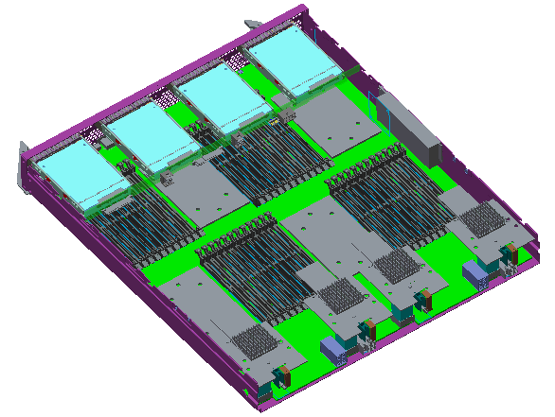
TC6600--Intel Brickland 和AMD 6300 四路计算节点
型号 | CB80-G20
CPU | 4个intel E7-4800V2/V3 系列—支持130w CPU
内存 | 48个DDR3插槽，、1600/1333/1066 Mhz,支持LV DIMM
硬盘 | 4个本地2.5寸SAS/SATA/SSD硬盘
RAID | 支持raid0,1,5 同时支持2G cache
IO 接口 | 2*PCI-E Gen3 16x Mezz 2*PCI-E Gen3 16x Mezz
型号 | CB85-G10
CPU | 4个AMD 0pteron 6300 全系列—支持140w CPU
内存 | 32个DDR3插槽，、1600/1333/1066 Mhz,支持LV DIMM
硬盘 | 4个本地2.5寸SAS/SATA/SSD硬盘，支持raid0,1,5，同时支持2G cache
RAID | 支持raid0,1,5 同时支持2G cache
IO 接口 | 2*PCI-E Gen2 8x Mezz 2*PCI-E Gen2 16x Mezz 内置一块标准PCI-E卡

